Slide 1


CSE 3021 – Social And Information Network Deep Learning on Graph Database using Neo4j (Review-2)
Team Members
Reg. No. Name
15BCE1252 Tushar Pahuja
15BCE1326 Osho Agyeya
15BCE1136 Pushpit Bagga
15BCE1257 Hargur Bedi
Faculty : Dr.L.Jani Anbarasi
VIT, Chennai.

Slide 2
ABSTRACT
Neo4j is a graph database management system developed by Neo4j, Inc. Described by its developers as an ACID -compliant transactional database with native graph storage and processing, Neo4j is the most popular graph database according to DB-Engines ranking, and the 22nd most popular database overall. Keras is an open source neural network library written in Python. It is capable of running on top of TensorFlow, Microsoft Cognitive Toolkit or Theano. Designed to enable fast experimentation with deep neural networks, it focuses on being user-friendly, modular, and extensible. The project is aimed to connect a Neo4j graph database to Keras. The main objective of the project is to create a neural network for a review prediction task. The model is trained on the set of review scores given by the persons for products. The database is created in Neo4j and it is injected into Keras learning model to make predictions regarding reviews of products.

Slide 3
MOTIVATION
The main motivation behind the project was to study the Machine Learning and Deep Learning concepts and learn how to apply them to real life applications. The aim was to study how people give ratings to different products based on various factors and how Deep Learning using Keras could be used to perform the prediction of ratings. Neo4j software would be used to represent the data in the form of a graph with people and products as nodes and study the relationship between them.

Slide 4
EXISTING SYSTEM
Various regression models using machine learning algorithms like Random Forest, Decision Tree and Support Vector Regression have been used for movie rating prediction tasks.
Pros
Cons
Simple to train the model on the dataset.
Ability to handle huge amounts of data.
Acts as a black box to the user due to the lack of proper visual understanding provided by the models.

Slide 5
PROPOSED SYSTEM
A Deep Learning Neural Network model is used for this project. The model has two dense layers, of width 6, with tanh activation layers. These give it room to separately combine the corresponding elements from the style preference of the persons and style of the movie vectors. Then an output layer of width one is applied, also with tanh activation. The network at this point has generated a single value, the prediction for the review score. With our model built, we compile it to use the popular Adam optimizer and mean squared error as the loss function.
Pros
The model used along with Neo4j graph database allows the learning system to explore more of your data.
The neural networks are well known for being good at memorizing huge amounts of data which in our case would lead to high accuracy of prediction.

Slide 6
SOFTWARE & HARDWARE REQUIREMENTS
SOFTWARE AND LANGUAGES
Neo4j, Python, Cypher, Keras
HARDWARE USED
ASUS GL552VW ROG, NVIDIA GeForce GTX 960M with Compute capability 6 running Windows Operating System

Slide 7
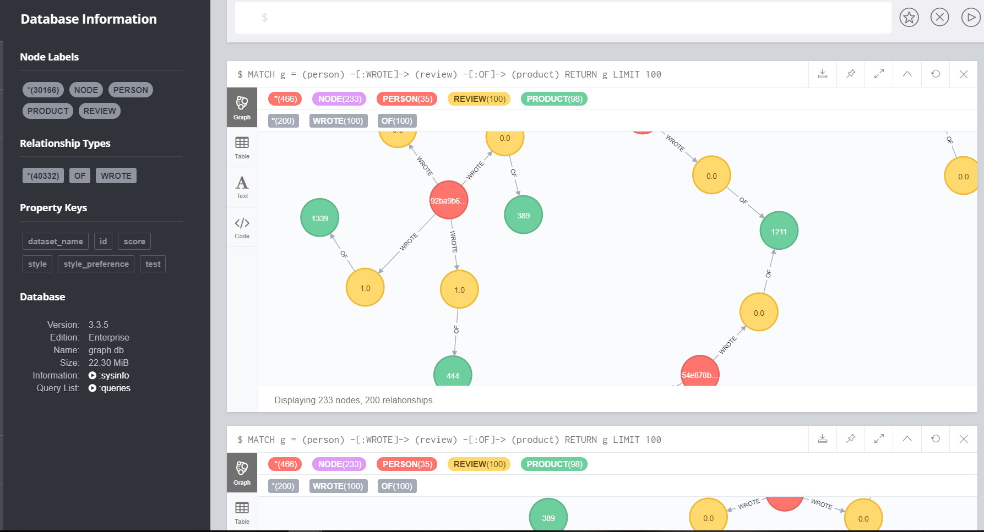
DATABASE CREATION IN NEO4J
Total Number of Nodes: 30166
Types of Nodes: Person, Review, Product
Types of Relationship: Wrote, Of

Slide 8
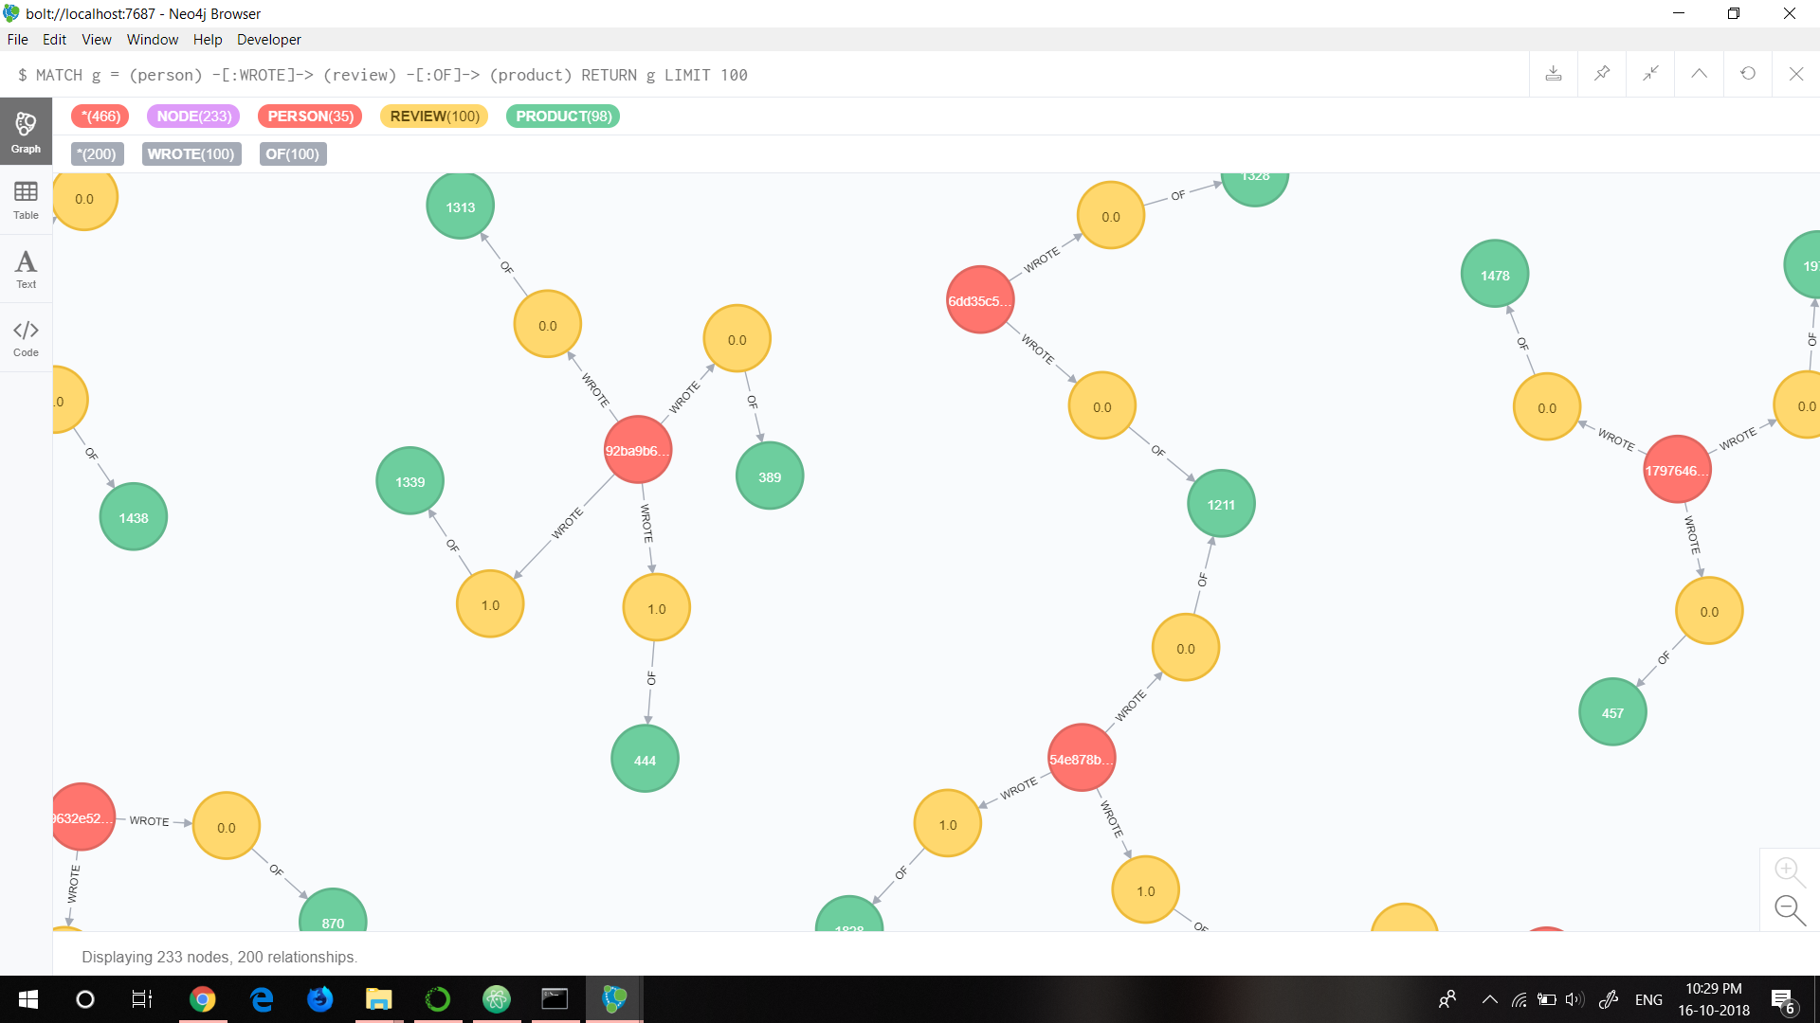
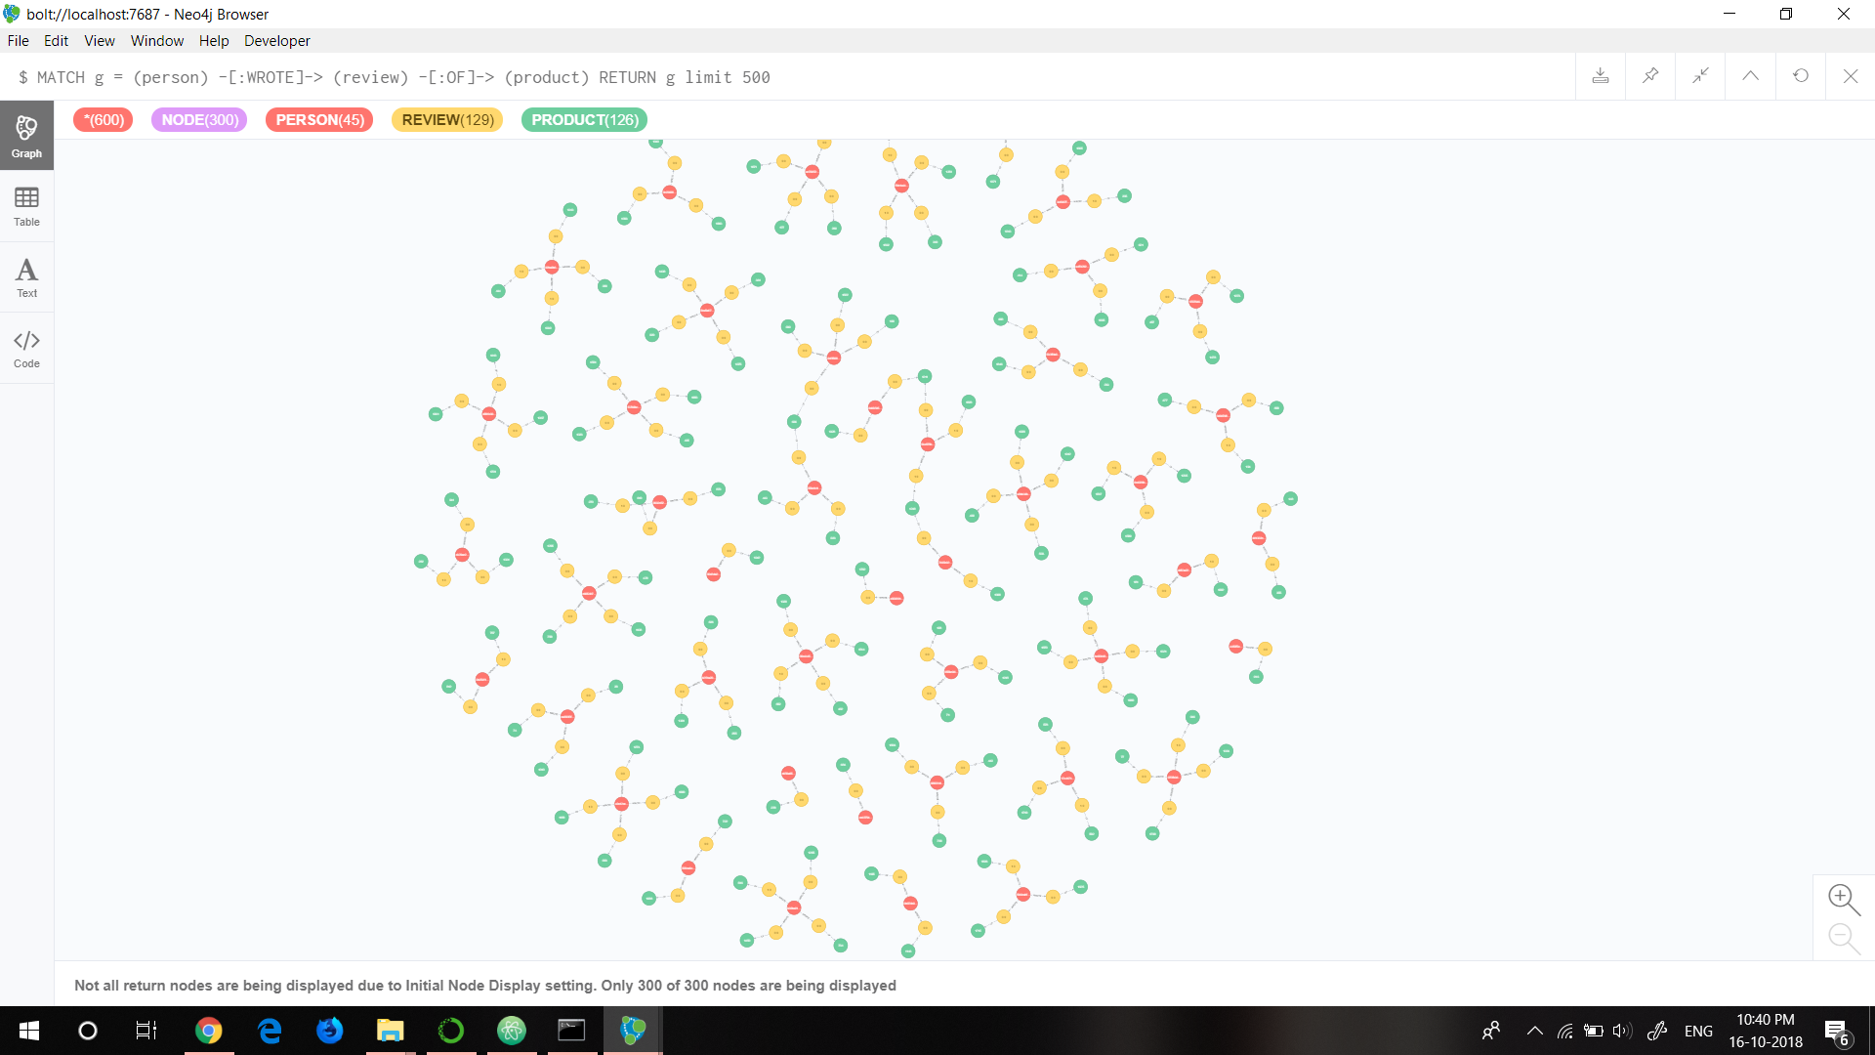
VISUAL REPRESENTATION OF DATABASE

Slide 9
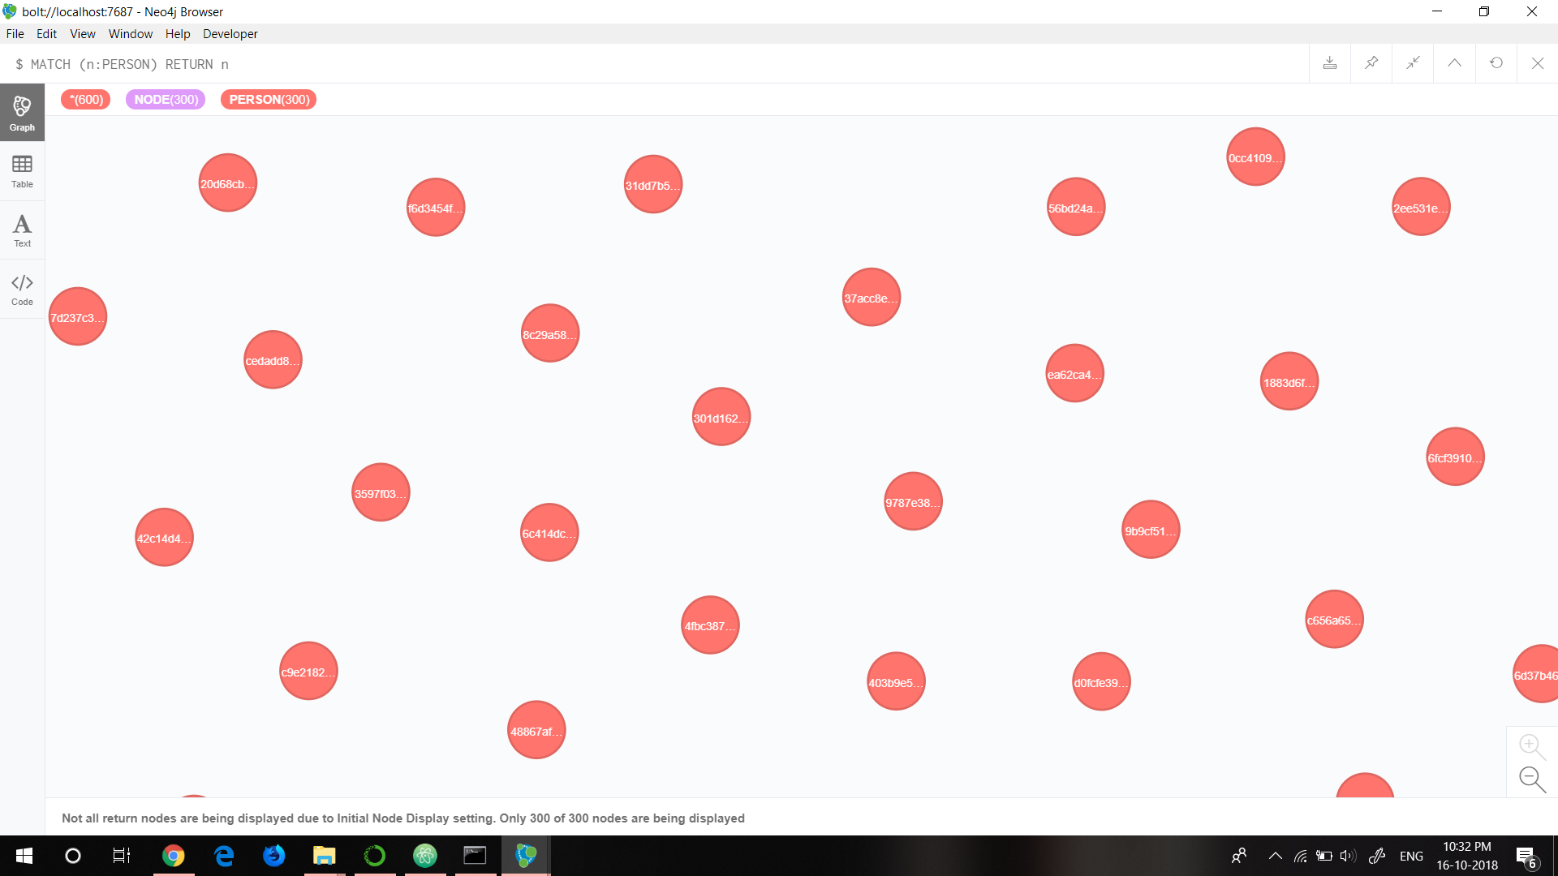
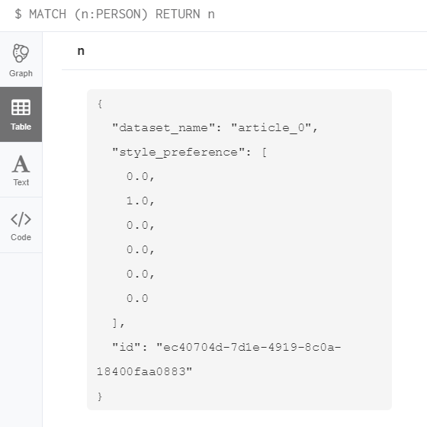
NODE: PERSON
Style preference is according to one hot encoding where 1 denotes preferred product type for a person and 0 denotes unlikely product type.

Slide 10
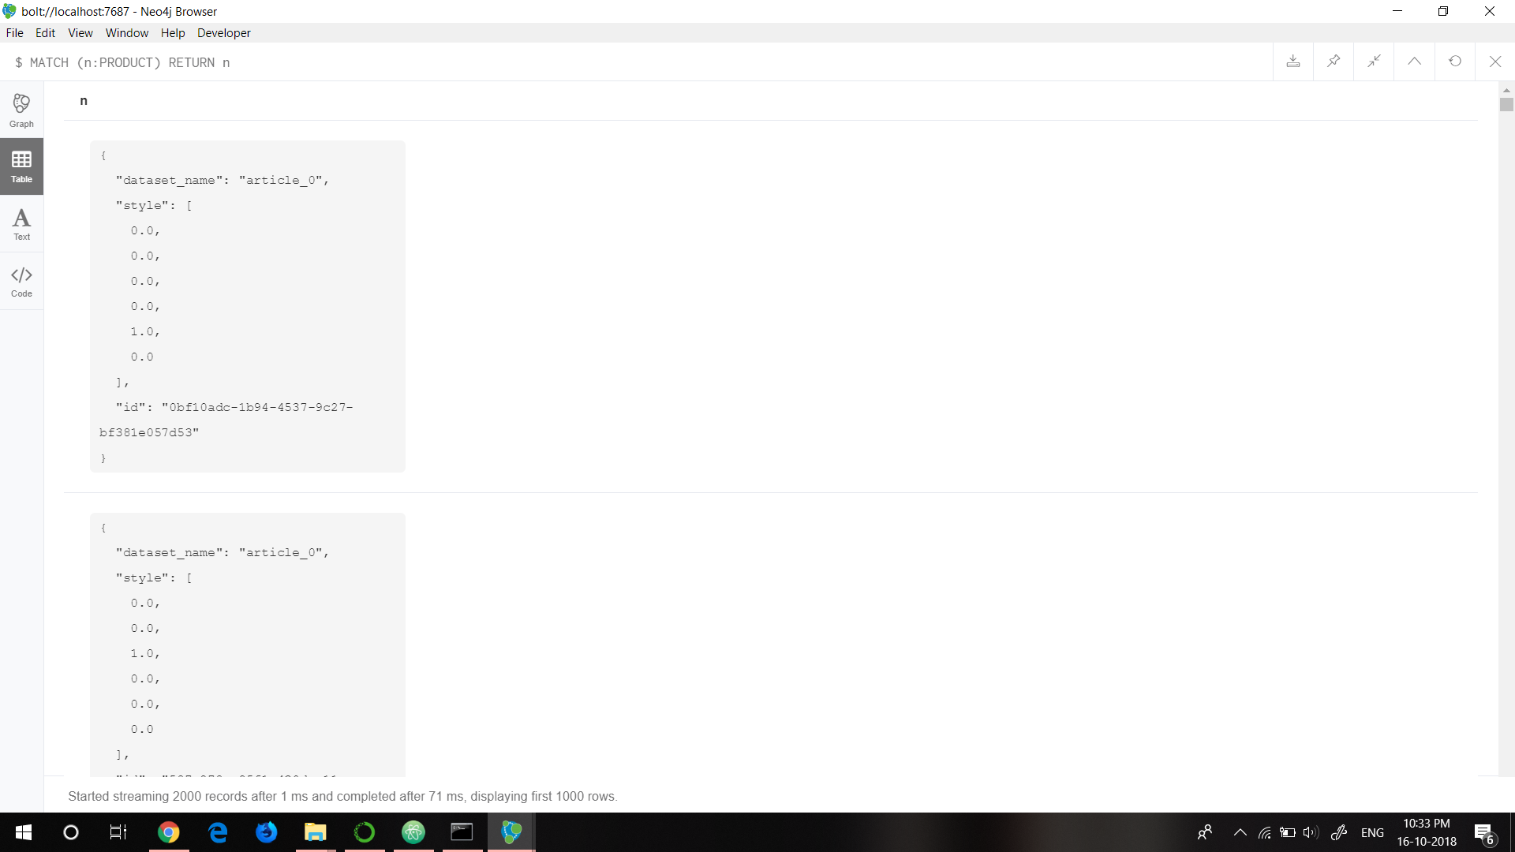
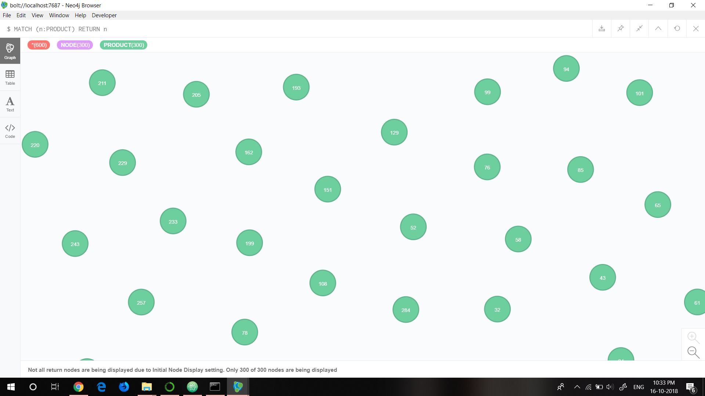
NODE: PRODUCT
Style preference is according to one hot encoding where 1 denotes the type of product and 0 the other way.

Slide 11
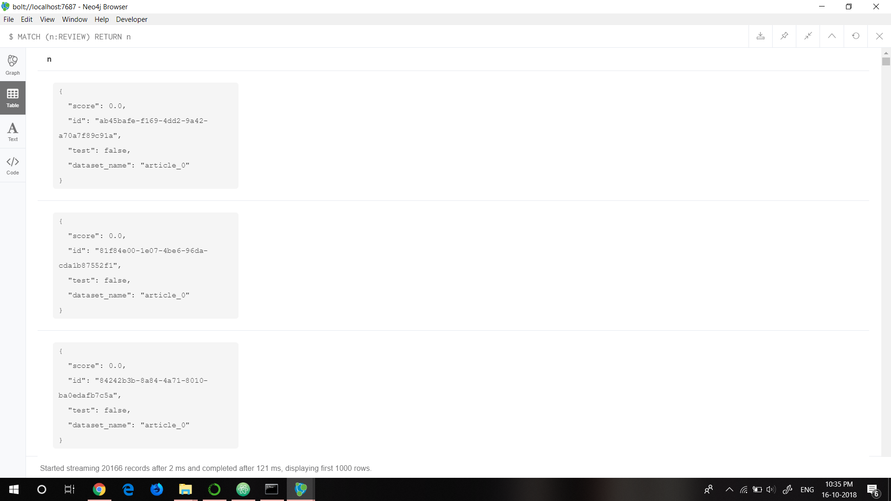
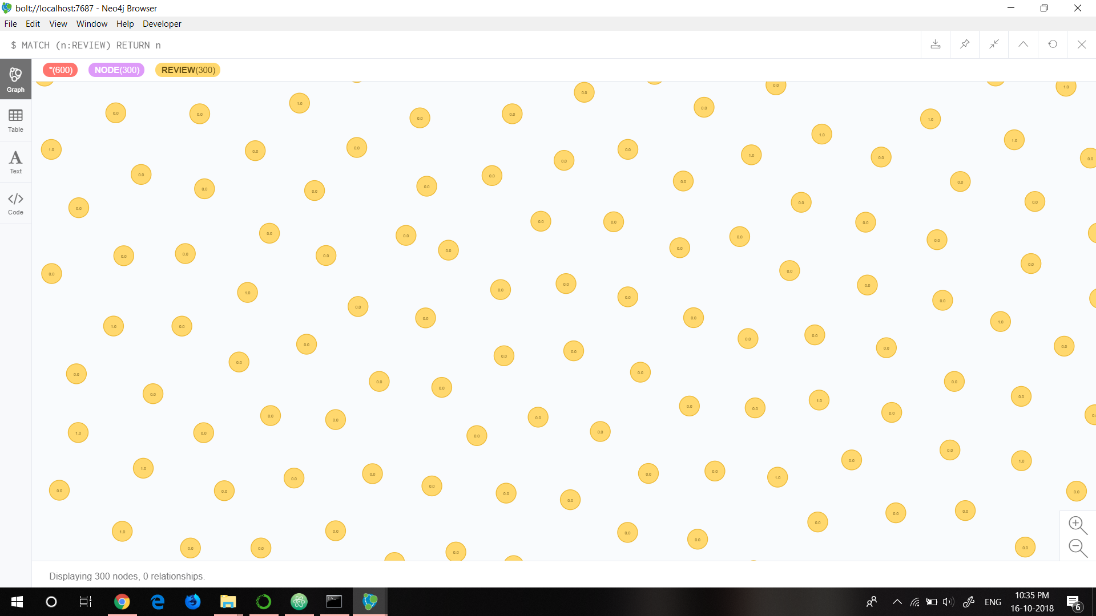
NODE: REVIEW
Review = Dot product of style preference vector of the person and the style vector of the product.
It can only take values 0 and 1.

Slide 12
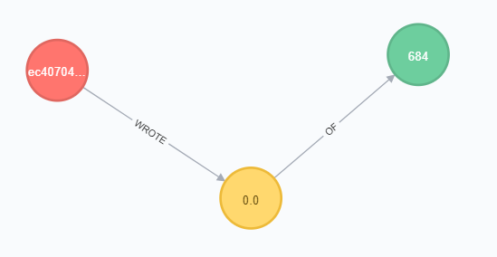
RELATIONSHIP BETWEEN THE NODES
Red: Person
Yellow: Review
Green: Product
RELATIONSHIP:
Person WROTE a review OF a product.

Slide 13
DEEP LEARNING SYSTEM ARCHTECTURE
A Deep Learning Neural Network model is used for this project. The model has two dense layers, of width 6, with tanh activation layers. These give it room to separately combine the corresponding elements from the style preference of the persons and style of the movie vectors. Then an output layer of width one is applied, also with tanh activation. The network at this point has generated a single value, the prediction for the review score. With our model built, we compile it to use the popular Adam optimizer and mean squared error as the loss function.

Slide 14
WORK PLANS FOR 3RD REVIEW
Deep Learning Model Completion
Training the Model
Getting the final predictions

Slide 15
REFERENCES
https://neo4j.com/docs/developer-manual/3.4/
https://keras.io/
Python Machine Learning by Sebastian Raschka
Neural Networks and Deep Learning by Coursera.com

Slide 16
THANKS!

